Slide 1


Introduction to R and RStudio
Fondren Library
Digital Scholarship Services

Slide 2
WHAT IS R?
Free, open-source
Data handling and storage
Programming language
Huge number of free packages give extended modeling, visualization, manipulation, and more capabilities

Slide 3
WHAT IS RSTUDIO?
Open-source, but not entirely free
Graphical user interface providing easy access to R
Not officially affiliated with R
Provides amazing cheat sheets!

Slide 4

THE RICE CONNECTION
Hadley Wickham
former Rice professor
Chief Scientist at Rstudio
Originator of the tidyverse
Author of “R for Data Science”

Slide 5
THE RSTUDIO INTERFACE
A walkthrough of important features

Slide 6
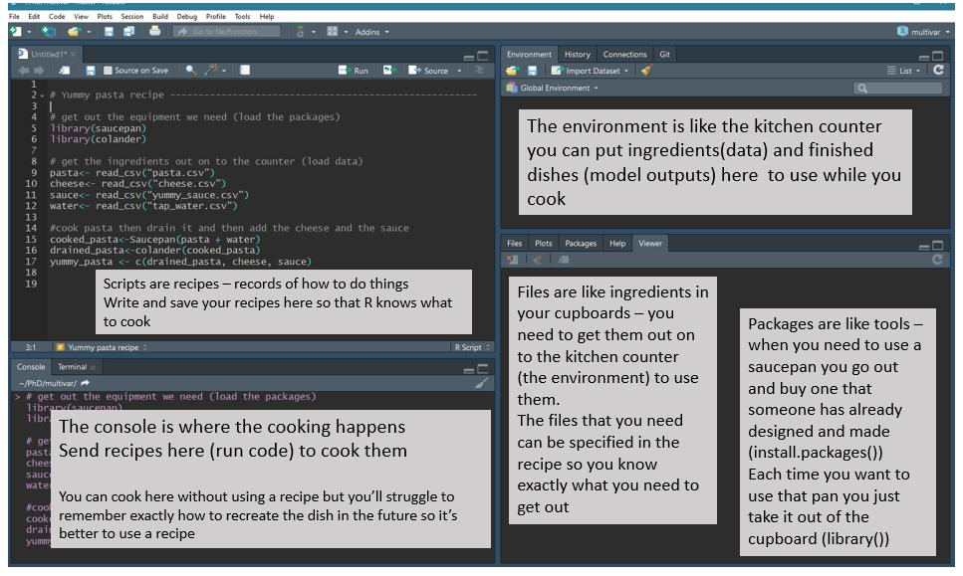

Slide 7
RSTUDIO INTERFACE

Slide 8
DATA TYPES
Scalars, lists, arrays, matrices, factors, data frames, and vectors

Slide 9
SCALARS
One value
Types:
Character: ‘a’
Numeric (decimal)
Integer
Logical: True or False
Complex
Special missing value: NA

Slide 10
VECTORS

Slide 11
LISTS

Slide 12
MATRICES
Arrays: just matrices with the option to have more dimensions

Slide 13
DATA FRAME

Slide 14
FACTORS

Slide 15
SIMPLE OPERATIONS
Arithmetic, assignment, matrix multiplication, converting between types

Slide 16
ARITHMETIC
Addition:
Subtraction:
Multiplication:
Division:

Slide 17
ASSIGNMENT
Naming a value
Name can change!

Slide 18
MATRIX MULTIPLICATION

Slide 19
TYPE CONVERSION

Slide 20
READING AND WRITING DATA
Excel, Comma-Separated and Tab-Separated Values, and more!

Slide 21
COMMON FILE FORMATS
Comma/Tab Separated Values: (.csv, .tsv)
Example
Excel files (.xlsx, .xls*)
JSON (.json)
Example
XML (.xml)
Example

Slide 22
READING FILE FORMATS
Comma/Tab Separated Values: (.csv, .tsv)
Read.csv
Excel files (.xlsx, .xls*)
JSON (.json)
Example
XML (.xml)
Example

Slide 23
WRITING FILE FORMATS
Comma/Tab Separated Values: (.csv, .tsv)
Write.csv
Excel files (.xlsx, .xls*)
JSON (.json)
Example
XML (.xml)
Example

Slide 24
DATA MANIPULATION
Subsetting and filtering

Slide 25
SUBSETTING
By Row:
By Column:

Slide 26
FILTERING

Slide 27
VISUALIZATION
Scatterplots, boxplots, and histograms

Slide 28
SCATTERPLOTS

Slide 29
HISTOGRAMS

Slide 30
BOXPLOTS

Slide 31
MODELING
Simple and Multiple Linear Regression

Slide 32
LINEAR MODELING

Slide 33
VISUALIZING LINEAR MODELS

Slide 34
ACKNOWLEDGMENTS
The R logo (https://www.r-project.org/logo/) is used under the terms of the Creative Commons Attribution-ShareAlike 4.0 International license.

